Slide 1
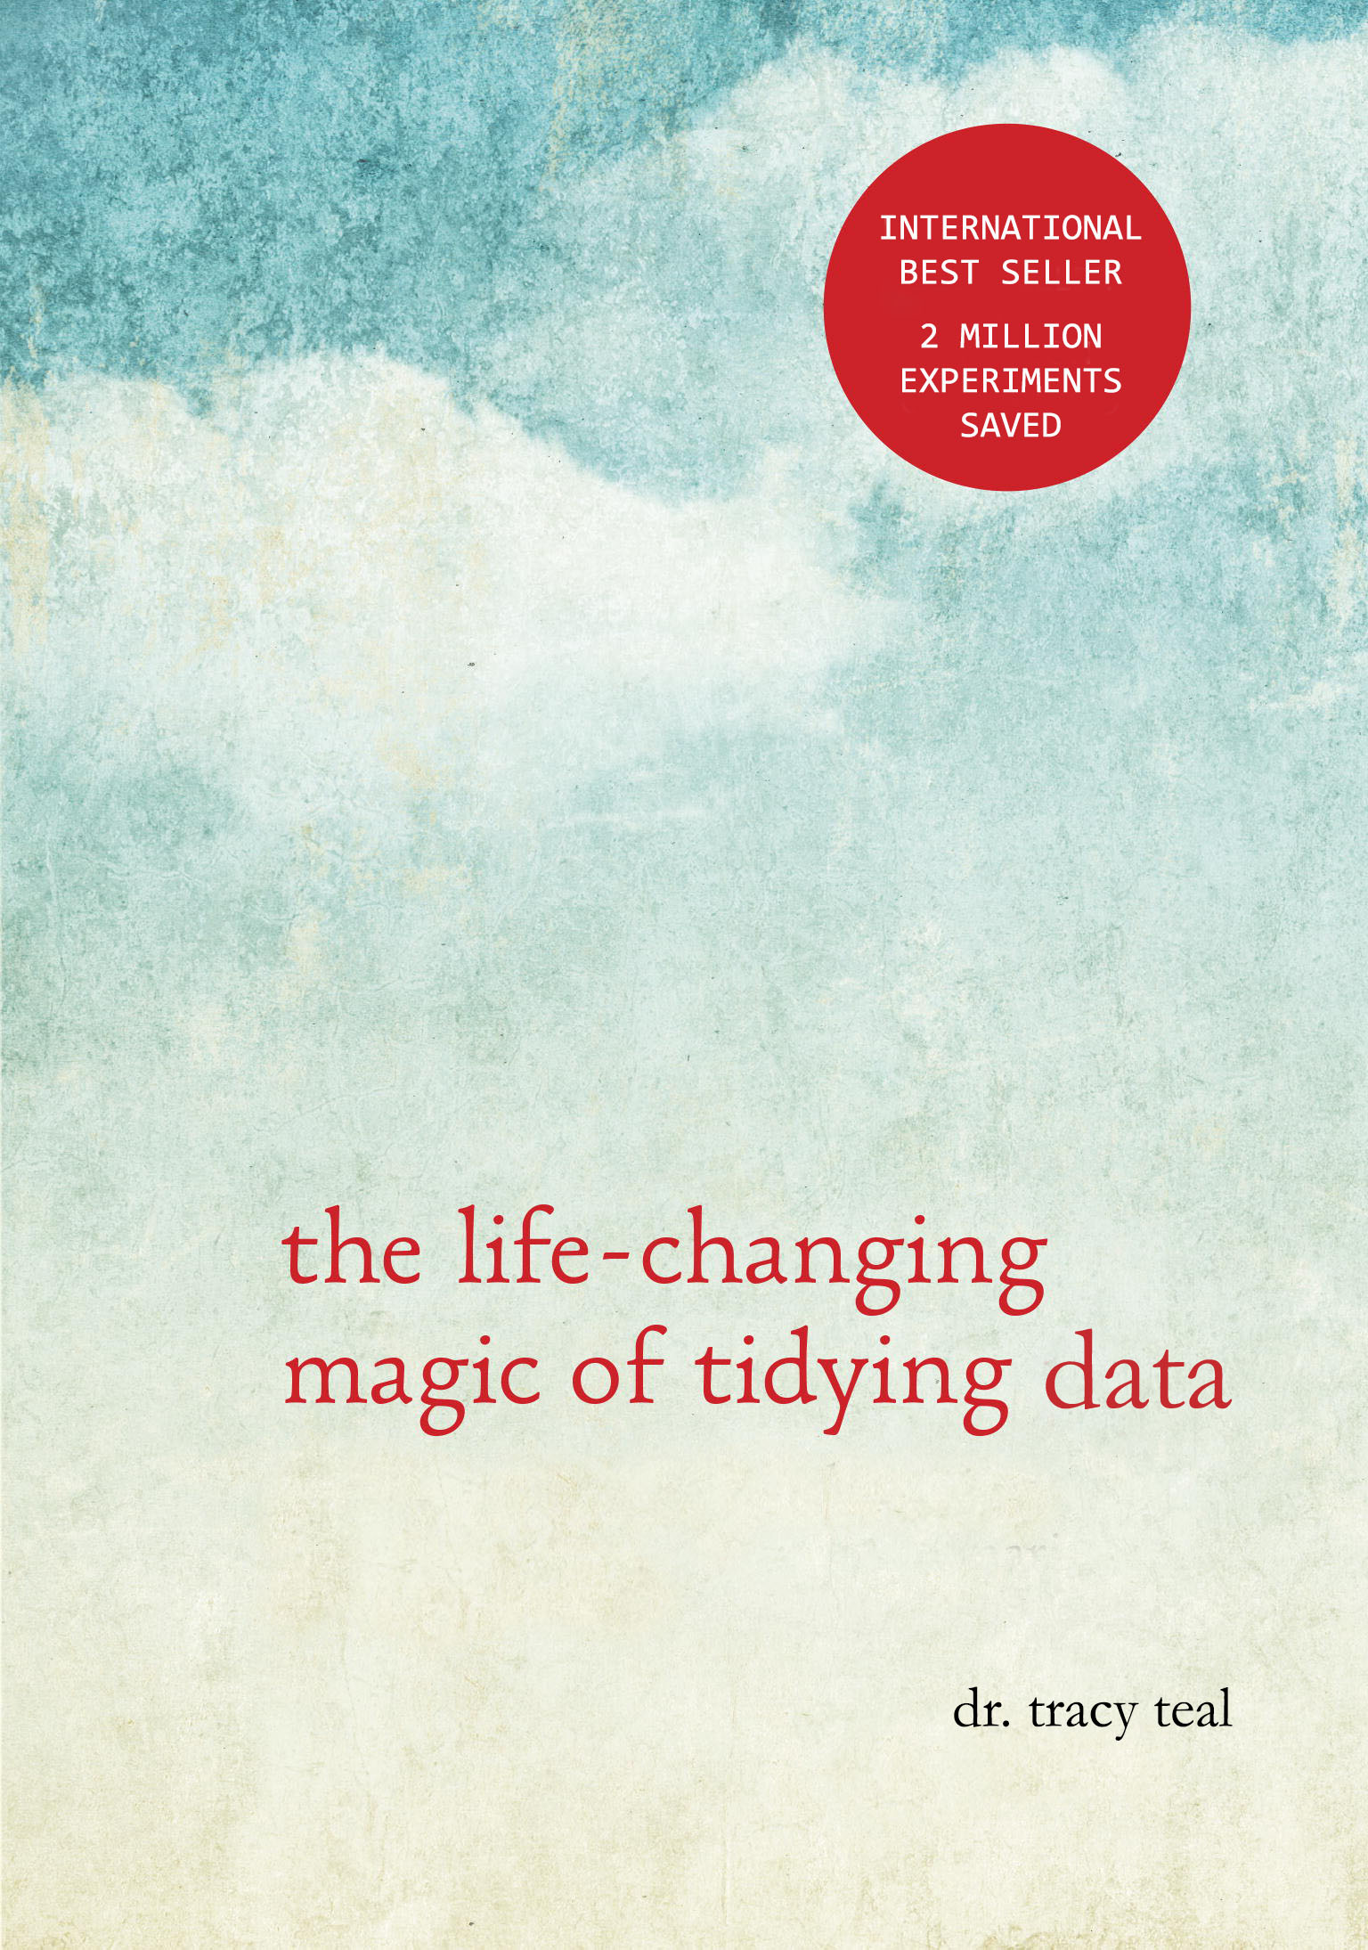

Slide 2
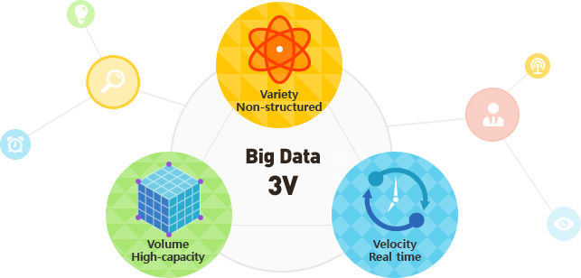
Our increasing capacity to collect data is changing research

Slide 3
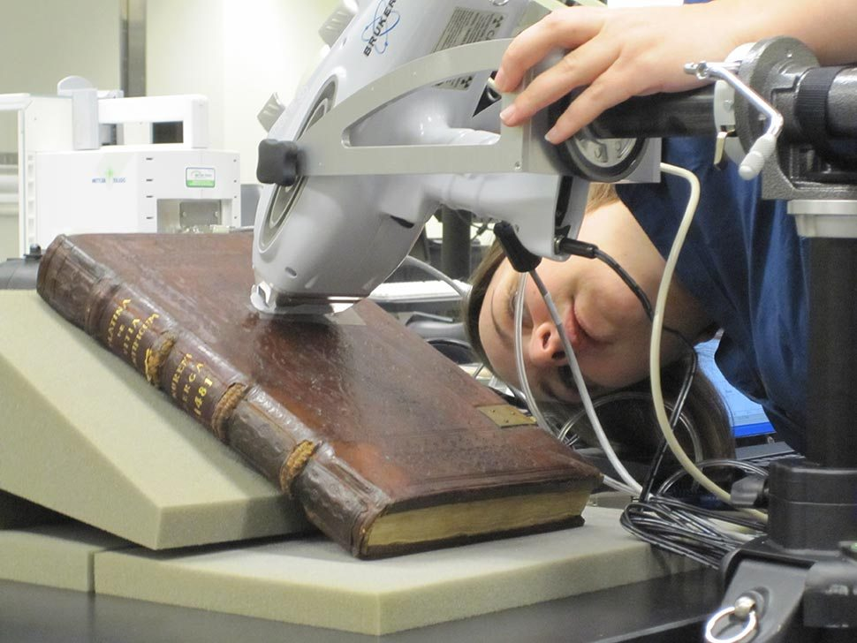
Data production is no longer the bottleneck
Notes:
Our increasing capacity to collect data is changing science. This is particularly true in genomics where, with high-throughput sequencing, data production is no longer a bottleneck.
Again, these plots keep increasing with technologies like NanoPore coming in to wider use, and we can only imagine what the next technologies will be.
This isn’t only genomics data either, there’s also all the ‘omics along with high throughput phenotype screening, imaging and even environmental data. And ideally we’d like to be able to integrate these different datasets.

Slide 4
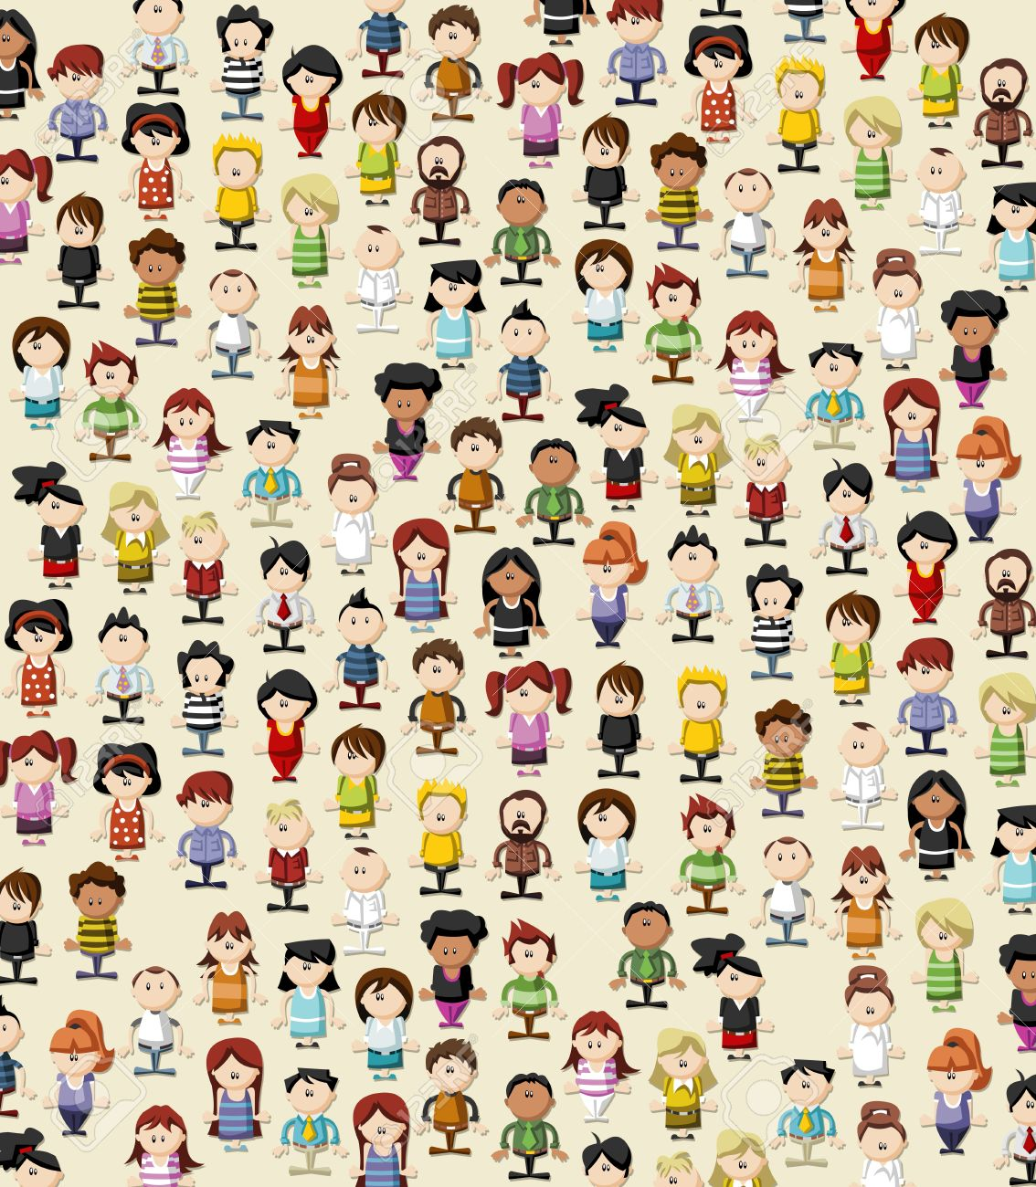
"Big data" is for every researcher

Slide 5
Every research project begins with data

Slide 6
… therefore tidy data is the foundation for effective and reproducible research

Slide 7
What is tidy data?
Raw data secure and backed up
Metadata collected, backed up and linked with raw data
Structuring data for computers to use it and tracking any data organizing steps
Cleaning data and tracking data cleaning steps

Slide 8
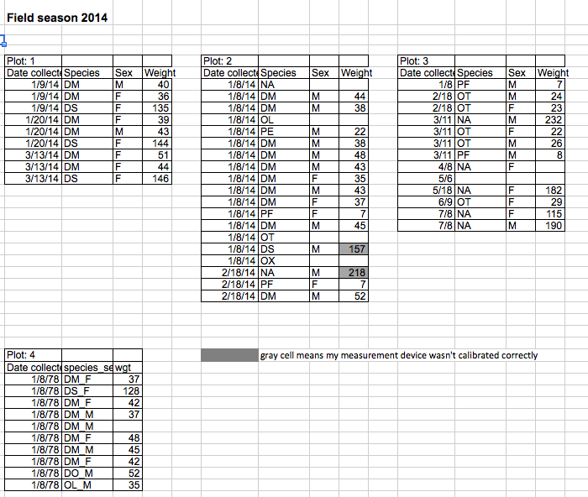

Slide 9
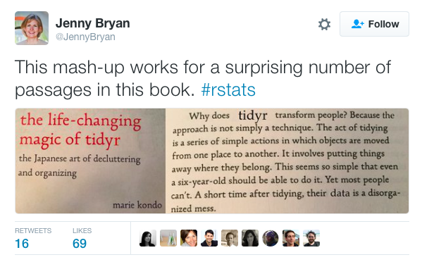

Slide 10
What are the challenges?

Slide 11
What are the challenges?
Lack of knowledge and skills by researchers
Accessibility of infrastructure and tools
Valuing data organization, management & provenance
Building a community of practice

Slide 12
Data literacy

Slide 13
How do we scale data literacy along with data production?

Slide 14
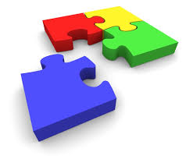
Training is the
missing piece
Training

Slide 15


Data pain

Slide 16
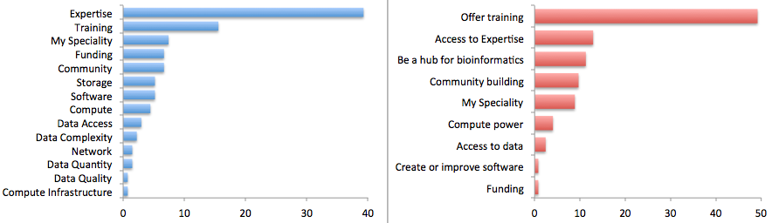
Most useful thing Bioinformatics Resource Australia could do is Offer Training

Slide 17
Where does this training come from?

Slide 18
Undergraduate courses
Graduate courses
Short courses
Workshops
MOOCs
Self-guided learning

Slide 19
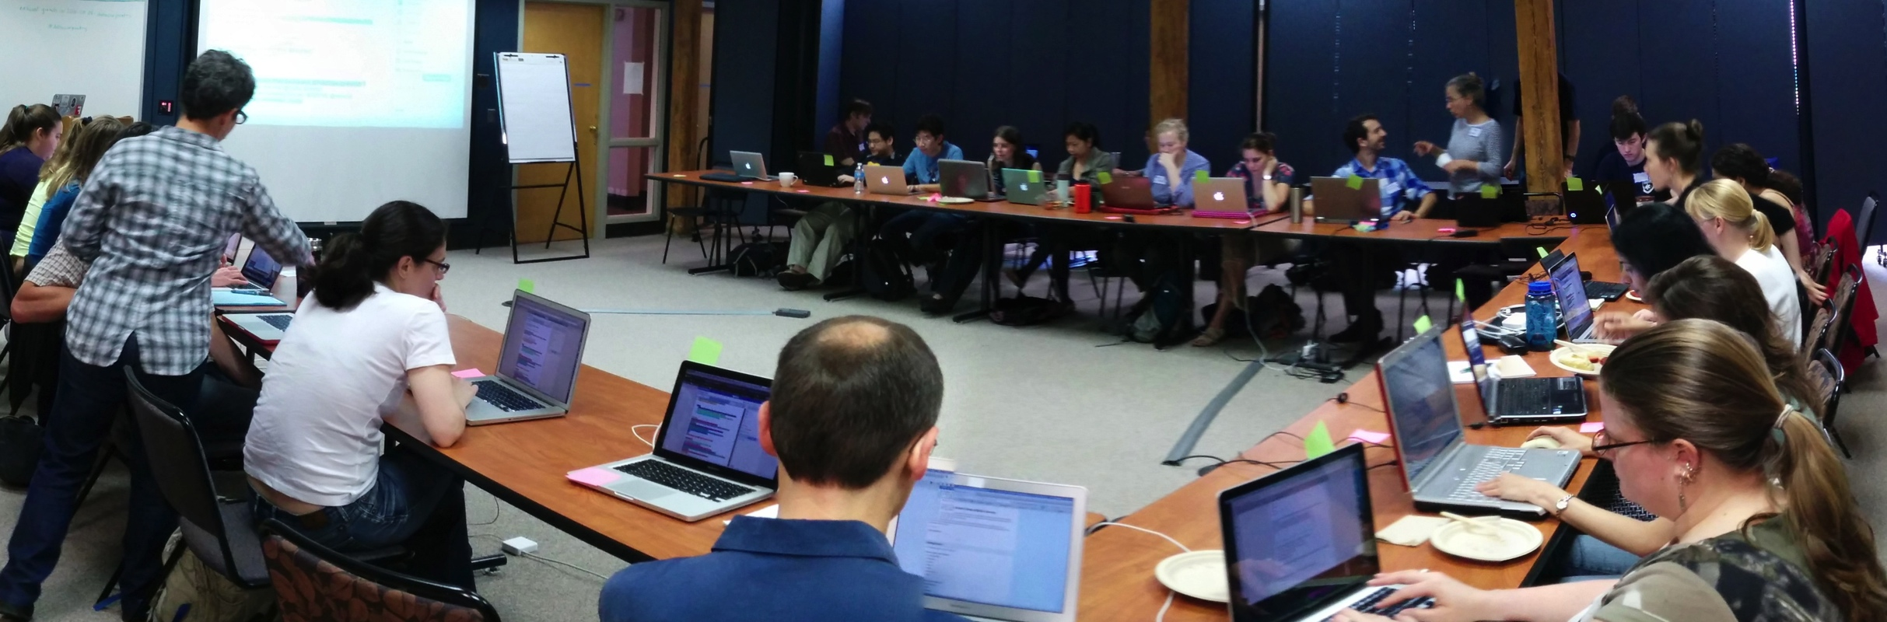
Data Carpentry
workshops

Slide 20
How do we do it?

Slide 21
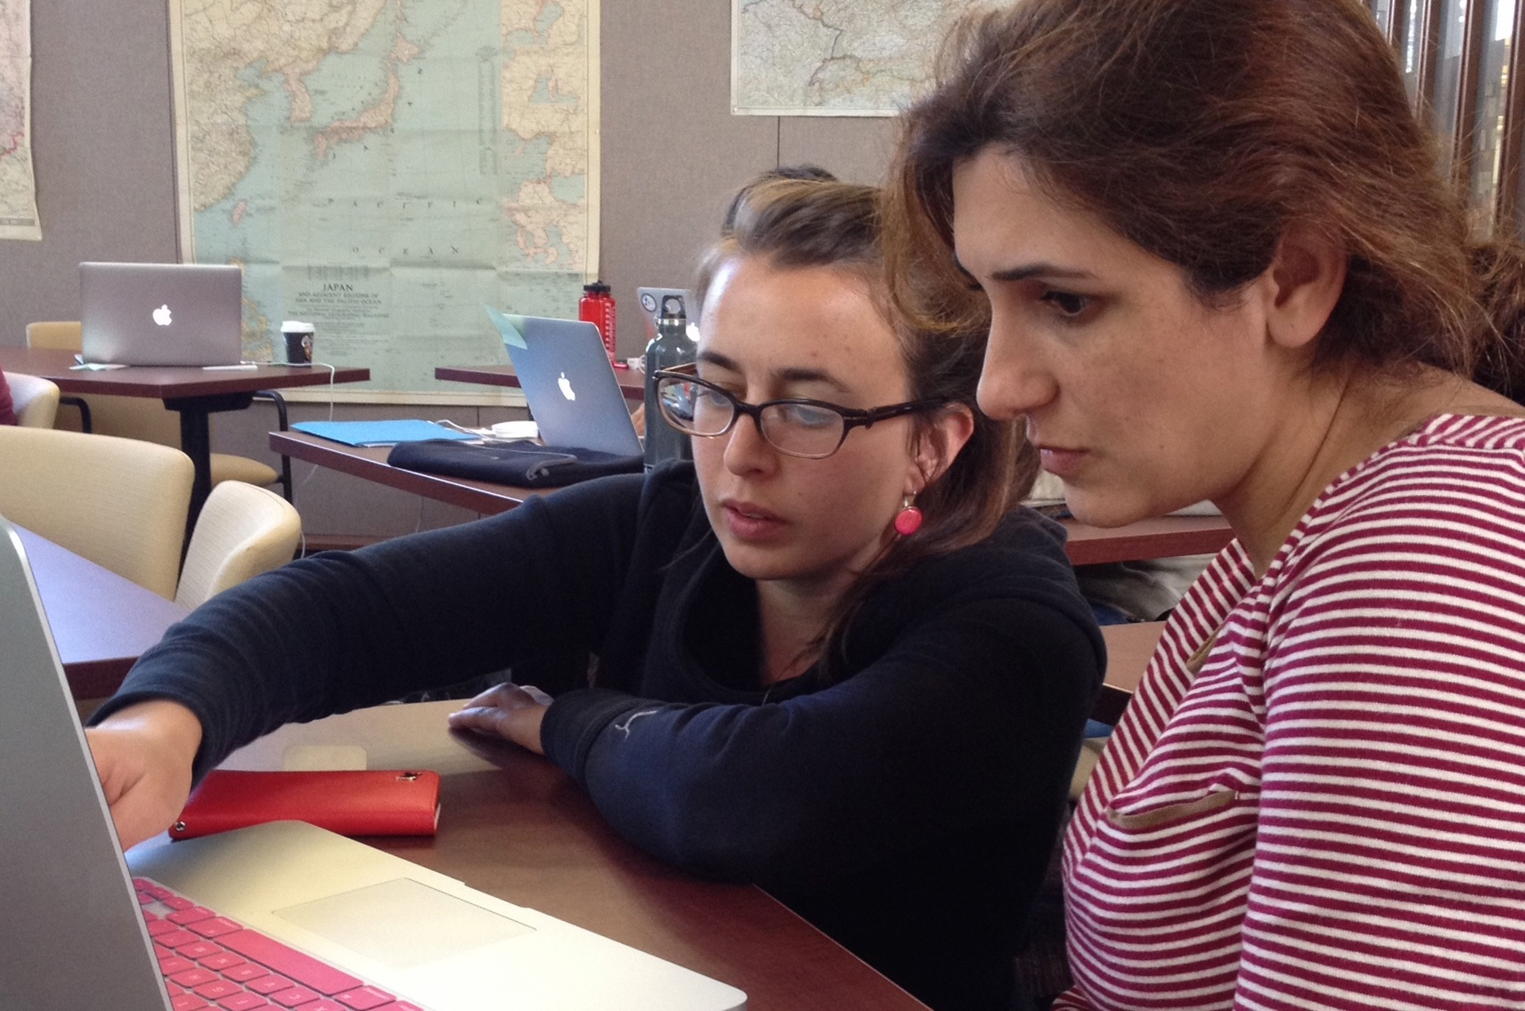
Hands-on instruction

Slide 22
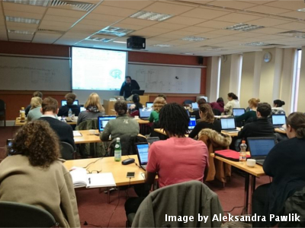
Hands-on intensive workshops
Two days
Hands-on
Qualified instructors
Helpers
Post-it notes!
Friendly learning environment
We can’t teach everything in two days, but the goal is to teach foundational skills to reduce the activation energy for getting started and to know what’s possible.

Slide 23
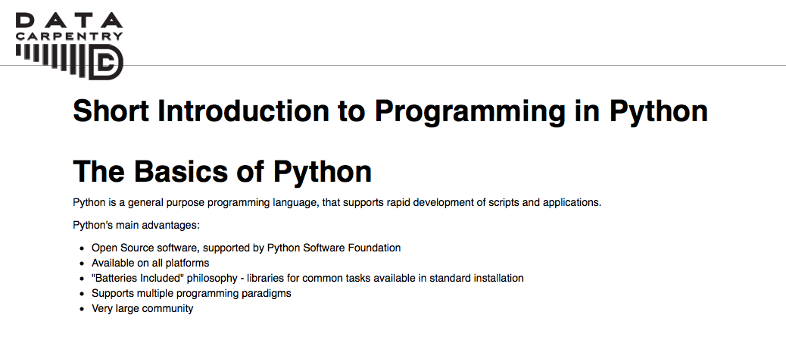
Collaboratively-developed
Openly-licensed materials

Slide 24
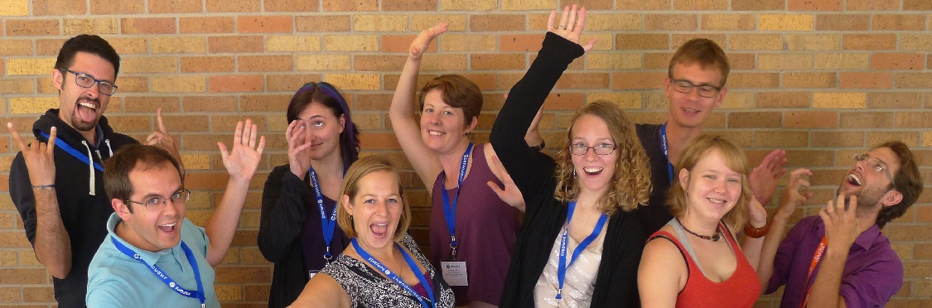
Volunteer instructors
Software Carpentry

Slide 25

Workshops
For people with little to no prior computational experience
Domain specific
Follow a narrative structure
Intro to the data type
Data & project organization
Data analysis & visualization
Data management
Data cleaning

Slide 26
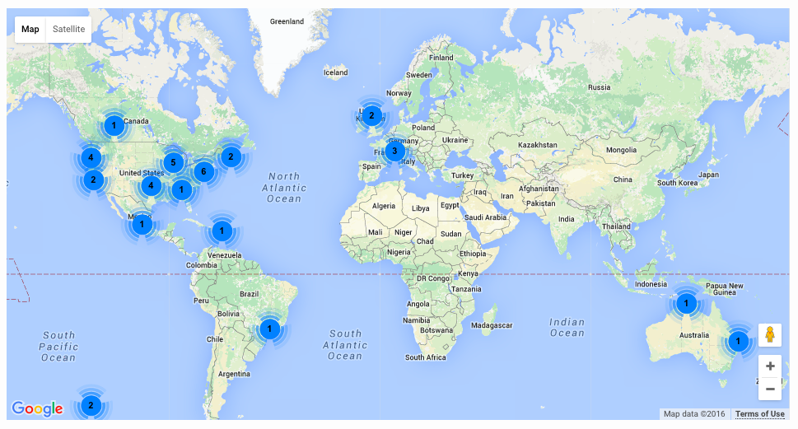
Workshops Worldwide
Since 2014:
Over 300 two-day workshops
Over 9000 learners
Taught by over 200 volunteers
In over 20 countries
Notes:
Materials and workshop model founded on successful SWC model
Workshops fill gaps
Demand continues to grow with a minimum of two workshops a week already scheduled in 2016

Slide 27
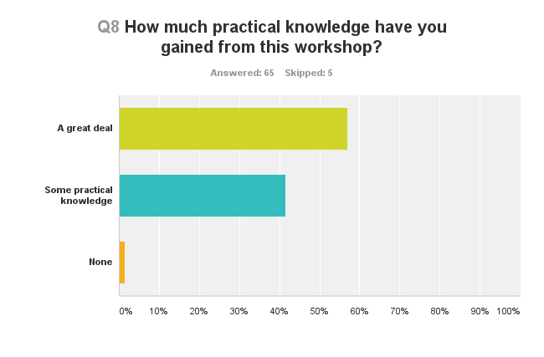
People are learning things

Slide 28
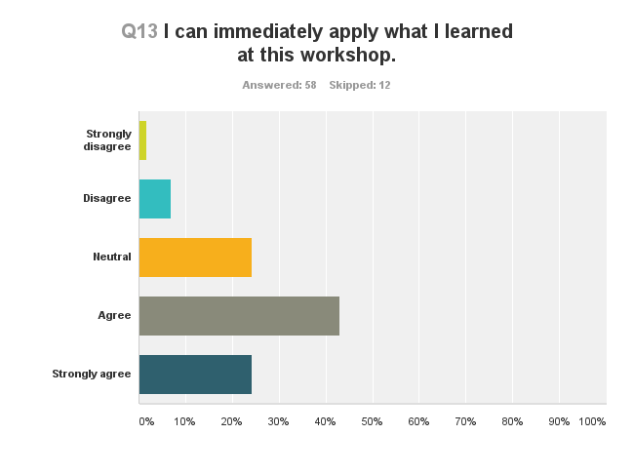
They feel the workshop was worthwhile

Slide 29
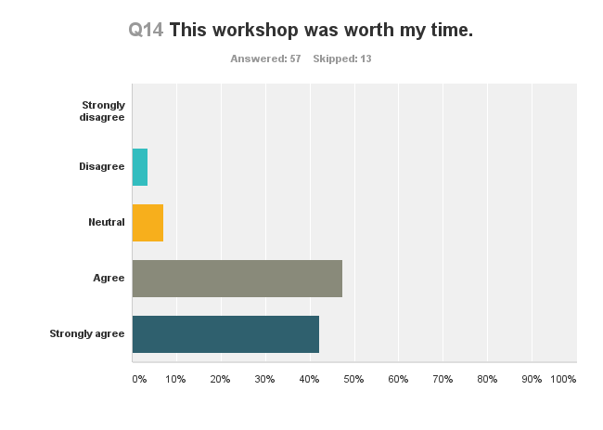
They feel the workshop was worthwhile

Slide 30
Hackathons to develop lessons
Genomics
project organization, command line, cloud
computing, using bioinformatics tools, data analysis and visualization
- CSHL, iPlant, SESYNC, iDigBio
Geospatial data (NEON)
Working with geospatial data
Library Carpentry
- Social sciences

Slide 31
Data organization lesson
Anything is possible if only you structure your data

Slide 32
Why is tidy data life changing?

Slide 33

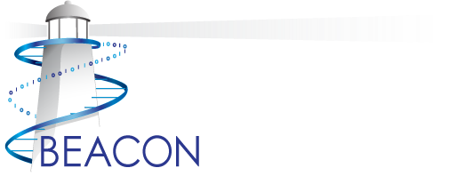





Support
Data Carpentry
Software Carpentry
http://software-carpentry.org/scf/partners/
Jason Williams at iPlant

Slide 34


Get involved!
Take a workshop
Become an instructor
Become a Partner
Support our efforts
http://www.datacarpentry.org
http://www.software-carpentry.org

